Slide 1
Shared Memory Parallel Programming
Lecture 10 (Part A)

Slide 2
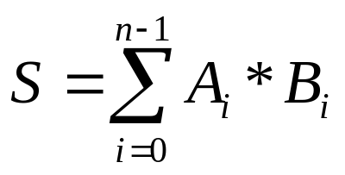
Goal
guide you to write parallel program computing the dot-product
with shared memory mechanism of UNIX

Slide 3
Shared Memory Programming Model
from the tradition of multi-programming
Virtual address spaces for a
collection of processes communicating
via shared addresses
Machine physical address space
P
n
p
r
i
v
a
t
e
L
o
a
d
P
n
Common physical
addresses
P
P
2
P
1
0
S
t
o
r
e
P
p
r
i
v
a
t
e
Shared portion
of address space
2
Private portion
of address space
P
1
p
r
i
v
a
t
e
P
0
p
r
i
v
a
t
e

Slide 4
Basic concepts
shared memory mechanism on UNIX

Slide 5
Shared memory in UNIX
a portion of a process’s virtual address space can be aliased to a block of shared memory
Proc. 1
Proc. 2
address
address
shared memory

Slide 6
Shared memory in UNIX
a portion of a process’s virtual address space can be aliased to a block of shared memory
Proc. 1
Proc. 2
x
address
address
y
shared memory

Slide 7
Shared memory in UNIX
a portion of a process’s virtual address space can be aliased to a block of shared memory
x=100
Proc. 1
Proc. 2
x
address
address
y
100
shared memory

Slide 8
Shared memory in UNIX
a portion of a process’s virtual address space can be aliased to a block of shared memory
Proc. 1
Proc. 2
a = y
got a==100
x
address
address
y
100
shared memory

Slide 9
Shared memory in UNIX
two processes may communicate through the shared memory
x=100
Proc. 1
Proc. 2
a = y
got a==100
x
address
address
y
100
shared memory

Slide 10
How to program

Slide 11
System calls for shared-memory
shmget
  to allocate a block of shared memory
shmat
  set alias let a portion of the address space been mapped to the shared memory block
shmdt
  detach the shared memory address mapping

Slide 12
Demo: shm
Proc. 1
Proc. 2
/* initial: flag = 0 */
value = 100;
flag = 1;
while (flag==0);
print value;

Slide 13
Initializing shared memory
with system call shmget

Slide 14
Initializing shared memory (1)
use key value
  shmid = shmget (key, size, flag)
first call allocates a new block of shared memory
following calls obtain this shared memory block with the same key

Slide 15
Initializing shared memory (1)
use key value
Proc. 1
Proc. 2
Proc. 3
Proc. 4
Proc. 5
Proc. 6
shared memory
shared memory
key=100
key=200

Slide 16
Initializing shared memory (2)
use key value IPC_PRIVATE
  shmid = shmget (key, size, flag)
always create a new shared memory block
then fork other cooperating process

Slide 17
Initializing shared memory (2)
use key value IPC_PRIVATE
Proc. 1
Proc. 1
Proc. 2
Proc. 3
shared memory
shared memory
fork
Proc. 1 allocates a new block
of shared memory

Slide 18
Demo: shm
Proc. 1
Proc. 2
/* initial: flag = 0 */
value = 100;
flag = 1;
while (flag==0);
print value;

Slide 19
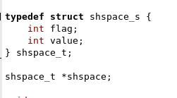
Demo: shm
create a block of shared memory
Proc. 1
Proc. 2
address
address
shared memory

Slide 20

Demo: shm
create a block of shared memory

Slide 21
Demo: shm
create a block of shared memory
setup access mode with a integer of bitmap

Slide 22
Demo: shm
create a block of shared memory
create/attach the shared memory and get a integer ID

Slide 23
Demo: shm
create a block of shared memory
bind the shared memory to my private virtual address

Slide 24
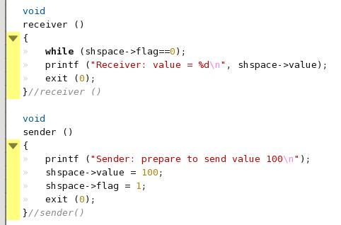
Demo: shm
access shared memory as if accessing to private virtual address space

Slide 25
Demo: shm
a simple method for synchronization
Proc. 1
Proc. 2
/* initial: flag = 0 */
value = 100;
flag = 1;
while (flag==0);
print value;

Slide 26
Semaphore
UNIX mechanism for mutual exclusive

Slide 27
Question: How to do critical section
every process doing both read and write
Proc. 1
Proc. 2
mysum = 0;
for (i=0;i<10000;i++)
mysum += a[i]*b[i];
lock (L);
acc += mysum;
unlock (L);
mysum = 0;
for (i=10000;i<20000;i++)
mysum += a[i]*b[i];
lock (L);
acc += mysum;
unlock (L);
acc
shared memory

Slide 28
How to share the play yard?
only one can use the play yard at a time

Slide 29
How to share the play yard?
only one can use the play yard at a time
The play yard is occupied and
I cannot use it

Slide 30
How to share the play yard?
only one can use the play yard at a time
OK I can go to the yard now

Slide 31
Semantics of semaphore
sem_wait (S) {
while (S<=0);
atomic {S=S-1;}
}
critical section
sem_post (S) {
atomic {S=S+1;}
}

Slide 32
Semantics of semaphore
sem_wait (S) {
while (S<=0);
atomic {S=S-1;}
}
each process calls sem_wait to acquire a lock for entering critical section
critical section
sem_post (S) {
atomic {S=S+1;}
}

Slide 33
Semantics of semaphore
sem_wait (S) {
while (S<=0);
atomic {S=S-1;}
}
S: the flag of the play yard
S<=0: someone in CS
S==1: no one in CS
critical section
sem_post (S) {
atomic {S=S+1;}
}

Slide 34
Semantics of semaphore
sem_wait (S) {
while (S<=0);
atomic {S=S-1;}
}
setting the flag has to be atomic
critical section
Atomic operation?
  no operation can be executed before the operation finished
sem_post (S) {
atomic {S=S+1;}
}

Slide 35
Realization of atomic operation
D. E. Culler, et. al, Parallel Computer Architecture: a Hardware/Software Approach

Slide 36
Semantics of semaphore
sem_wait (S) {
while (S<=0);
atomic {S=S-1;}
}
critical section
each process calls sem_post to release the lock
(let other process entering CS)
sem_post (S) {
atomic {S=S+1;}
}

Slide 37
Semaphore is more than a flag
a linked list to booking all processes waiting to enter the critical section
proc. 1
proc. 2
proc. 3
sem_wait (S);
…CS …
sem_post (S);
sem_wait (S);
…CS …
sem_post (S);
sem_wait (S);
…CS …
sem_post (S);
semaphore S
proc. 1
proc. 2
proc. 3
Kernel

Slide 38
Demo: semaphore

Slide 39
What the sample code does
Proc. 1
Proc. 2
Proc. 3
Proc. 4
acc = acc + …;
acc = acc + …;
acc = acc + …;
acc = acc + …;
acc
shared memory

Slide 40
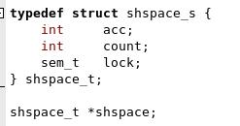
Content of the shared memory space
Proc. 1
Proc. 2
address
address
shared memory

Slide 41
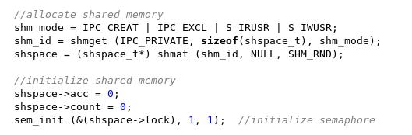
Initialization

Slide 42
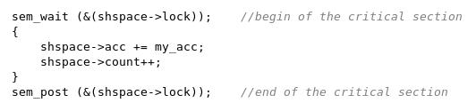
The critical section

Slide 43
Other parallel programming mechanisms

Slide 44
System calls to use message passing mechanism on UNIX
msgq_id = msgget (key, flag)
msgsend (msgq_id, buf, size, flag)
msgrcv (msgq_id, buf, size, type, flag)

Slide 45
Multi-threading
light-weight process
  multiple flows of control (instruction sequences) having the shared address space in one process
  each thread has its own program counter, register file image, and stack

Slide 46
UNIX support for multi-threading
create and terminate a thread
  pthread_create
  pthread_exit
  pthread_join
thread synchronization
  pthread_mutex_init
  pthread_mutex_destroy
  pthread_mutex_lock
  pthread_mutex_trylock
  pthread_mutex_unlock

